Slide 1
Open Copyright License
Photo by Aaron Burden on Unsplash (Cropped)

Slide 2
© Copyright

Slide 3
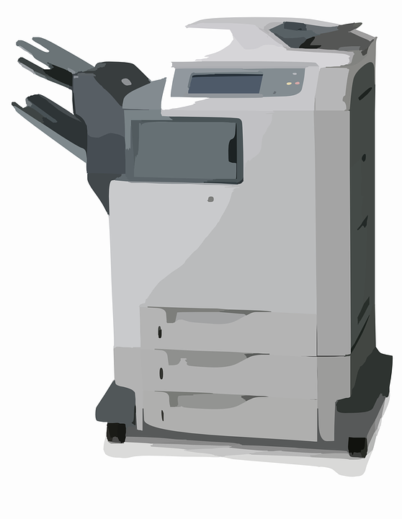
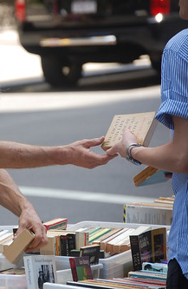
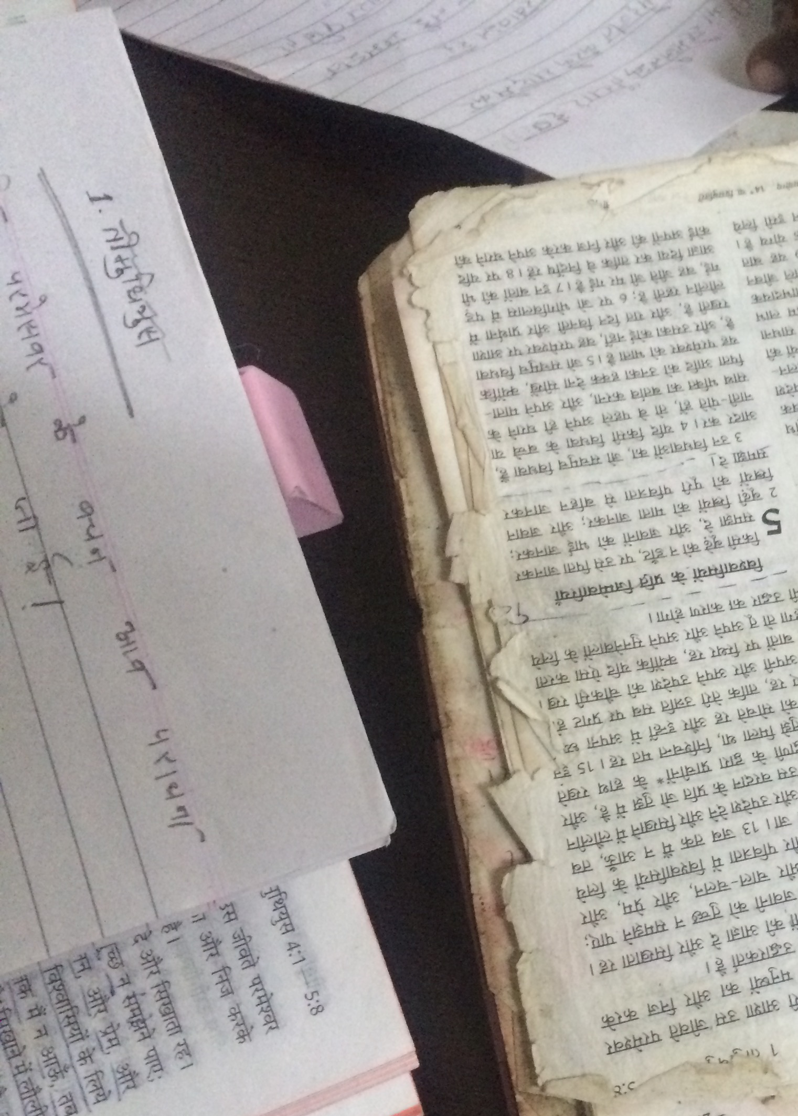
Exclusive rights granted to copyright owner
Make copies
Distribute and sell copies
Make adaptations
This Photo by Unknown Author is licensed under CC BY-NC

Slide 4
All rights are reserved. Without additional permission others cannot:
Make copies
Distribute and sell copies
Make adaptations



This Photo by Unknown Author is licensed under CC BY-NC
Getting permission can be a lengthy and costly process.

Slide 5
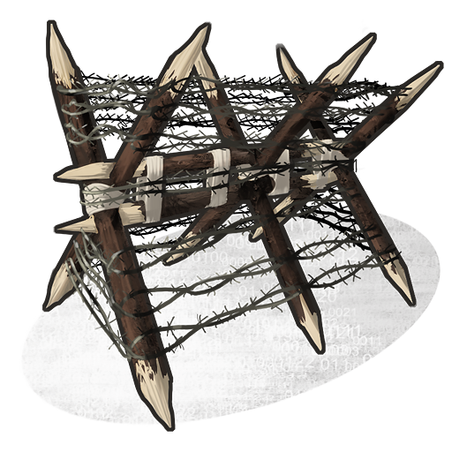
© Copyright (All Rights Reserved) as is:
Source
Translation
Community
This Photo by Unknown Author is licensed under CC BY-SA-NC

Slide 6
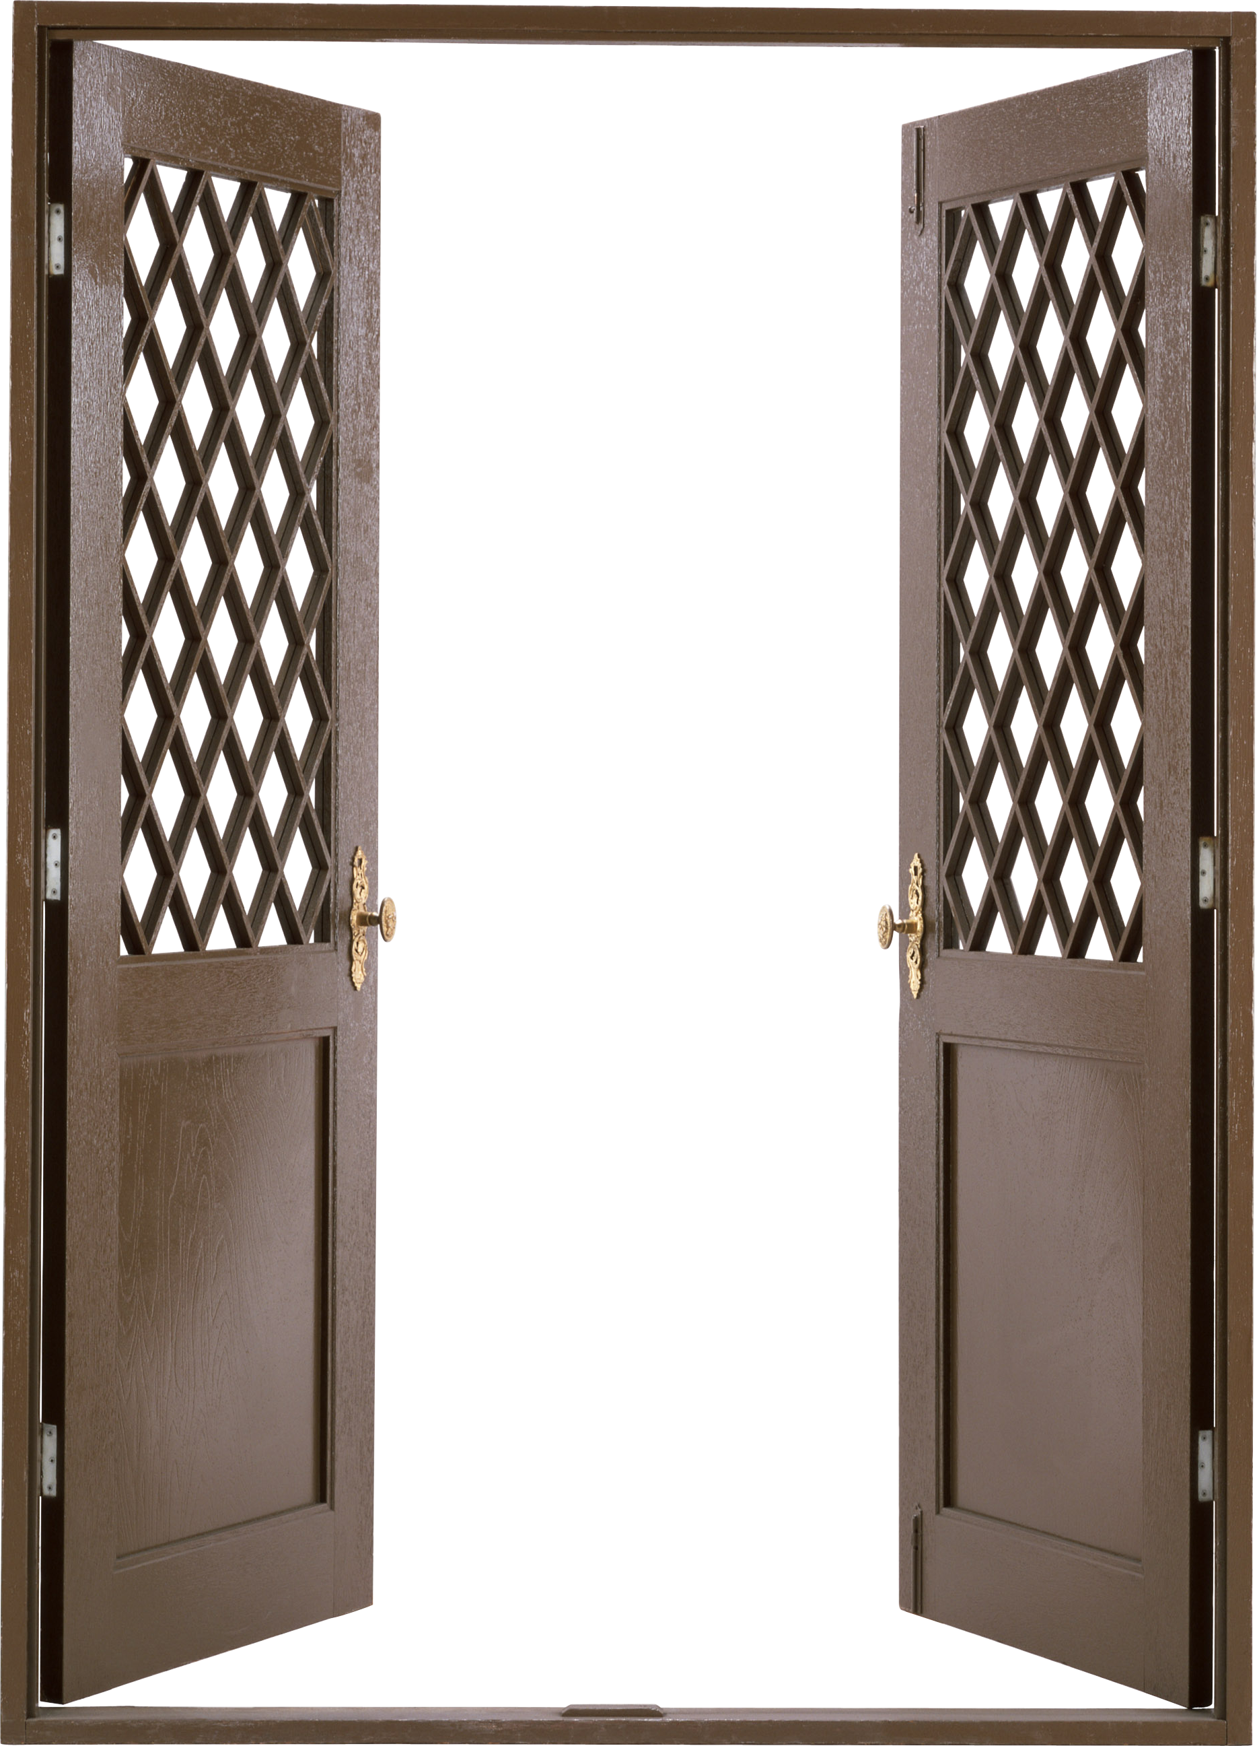
keep © copyright but grant more freedom?
Source
Translation
Community
This Photo by Unknown Author is licensed under CC BY-NC

Slide 7


Slide 8
Ability to give permission before being asked
Rights to copy, distribute, display, and perform

Slide 9
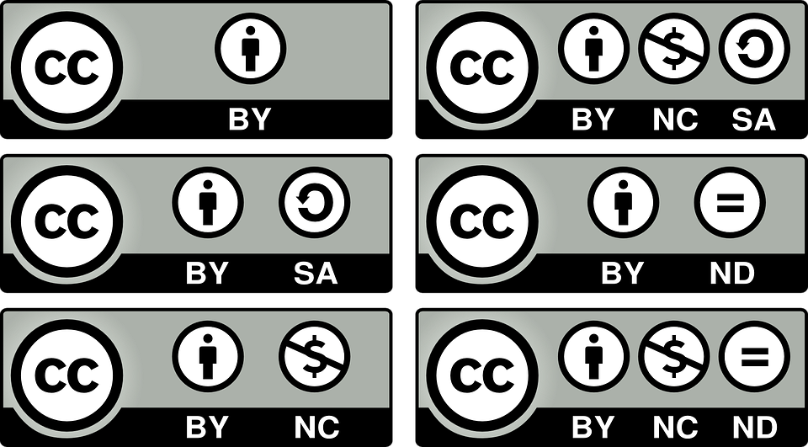
Creative Commons Attribution - Share Alike
Free to copy and redistribute the material in any medium or format.
Free to remix, transform, and build upon the material for any purpose,
even commercially.
Creator must be acknowledged.
Adaptations must have the same license as original.

Slide 10
Attribution
This license allows reusers to distribute, remix, adapt, and build upon the material in any medium or format, so long as attribution is given to the creator.
You must provide a link to the license.
https://creativecommons.org/licenses/by-sa/4.0/
You may not suggest the licensor endorses you or your use.

Slide 11
Share Alike
If you remix, adapt, or build upon the material, you must license the modified material under the same license as the original.
Slides adapted from https://docs.google.com/presentation/d/1xRsF5LrTSGzrQ6o4fW9xemthraKJ4IKLpfNBaDh5QkA/edit#slide=id.p and https://creativecommons.org/ site.

Slide 12
© with CC BY-SA license—permission is granted in advance to:
Make copies
Distribute and sell copies
Make adaptations



This Photo by Unknown Author is licensed under CC BY-NC

Slide 13


© with CC BY-SA license—permission is granted in advance to:
Make copies
Distribute and sell copies
Make adaptations



This Photo by Unknown Author is licensed under CC BY-NC
You Must
Give attribution. Share alike.

